Slide 1
INF10025
Data Management and Analytics
Lecture 10 – Part 3
JSON

Slide 2
Searching for data in a NOSQL database
Can you guess which language you use to search a NoSQL database?
If you said SQL – you are Correct!!!!
That's right , SQL is used to search a NoSQL database.
  Actually it’s called DocumentDB SQL.
  It is a subset of the normal SQL standard.
Remember:
  A NoSQL database really means A Non Relational database
  NoSQL actually stands for Not Only SQL

Slide 3
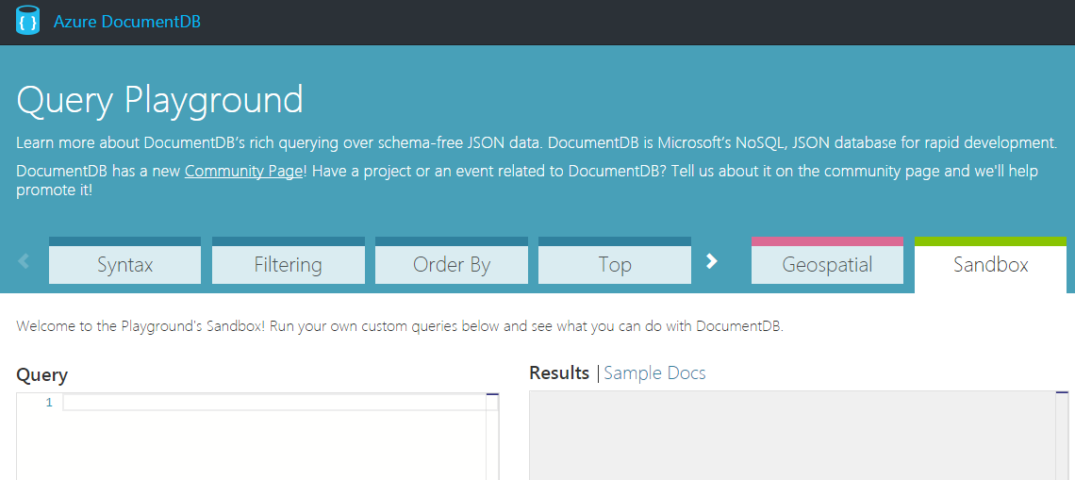
Query Example
Students can create a free Azure login via DreamSpark
https://catalog.imagine.microsoft.com/en-us/Catalog/Product/99
There you can create your own DocumentDB
However, Microsoft have also provided a free DocumentDB Query Playground
You use an existing database (they provide it) and you can run test queries etc.

Slide 4
The Family collection
One of the collections is called FAMILY.
Some of the properties stored in the Documents are:
      FAMILY
      id
      lastname
      parents
      givenName OR
      firstName
      familyName
      children
      givenName
      gender
      grade
      pets
      givenName
      address
      state
      county
      city

Slide 5

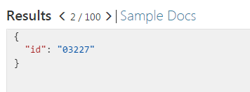
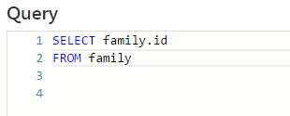
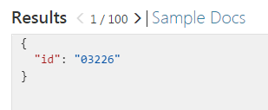
Query Example
Use SQL to retrieve data in the same manner as you would with a RDBMS
Click the > symbol to scroll to next result

Slide 6
Playground Bugs / Issues
There seems to be a BUG in the Azure DocumentDB Query Playground
(or more likely I am not using 100% correctly)
  Queries for the Family collection seems to also retrieve data from the Food collection.
  All Food documents have an id of 5 digits
  All Family documents have an id longer than 5 digits
So many examples below have the following where clause
WHERE LENGTH(f.id) > 5
Also some documentation says FAMILY and some says FAMILIES.
  Both seem to work identically

Slide 7
Using aliases instead of the table name
SELECT f.id
FROM Families f
WHERE LENGTH(f.id)>5
6 Results
"AndersenFamily"
"MeyerAndFamily"
"TheSmiths"
"TheAlexanders"
"WakefieldFamily"
"KinDocument" (This document doesn't seem to contain any family data)

Slide 8
Using the ID in the Where clause
If you know the id of a document, you can use that in the WHERE clause
SELECT f.id
FROM Families f
WHERE f.id = "AndersenFamily"
1 Results
"AndersenFamily"
It is better to use the UPPER function
WHERE UPPER(f.id) = "ANDERSENFAMILY"

Slide 9
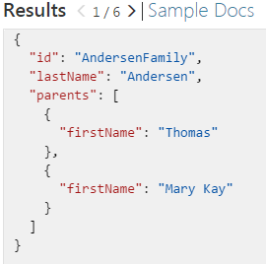
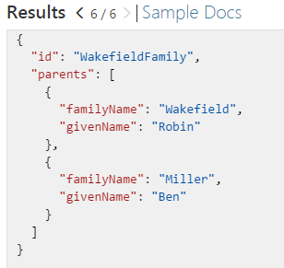
Retrieve multiple columns
SELECT f.id, f.lastName, f.parents
FROM Families f
WHERE LENGTH(f.id)>5
6 Results
You can see that the properties found in each document differ slightly

Slide 10
STARTSWITH() & CONTAINS () functions
SELECT f.id, f.lastName, f.parents
FROM Families f
WHERE LENGTH(f.id)>5
AND STARTSWITH(f.id, "The") retrieves 3 & 4
SELECT f.id, f.lastName, f.parents
FROM Families f
WHERE LENGTH(f.id)>5
AND STARTSWITH(UPPER(f.id), "THE") retrieves 3 & 4
SELECT f.id, f.lastName, f.parents
FROM Families f
WHERE LENGTH(f.id)>5
AND CONTAINS(f.id, "M") retrieves 2
SELECT f.id, f.lastName, f.parents
FROM Families f
WHERE LENGTH(f.id)>5
AND CONTAINS(UPPER(f.id), "M") retrieves 1, 2, 3 & 5
Data
"AndersenFamily"
"MeyerAndFamily"
"TheSmiths"
"TheAlexanders"
"WakefieldFamily"
"KinDocument"
1
2
3
4
5
6

Slide 11
INDEX_OF () function
The INDEX_OF function returns the starting position of a string within a larger string.
This example searches for the text "Family" within the f.id property.
If not found the function returns -1
INDEX_OF("ANDERSENFAMILY","FAMILY")
returns a value of 8.
INDEX_OF("ANDERSENFAMILY","A")
returns a value of 0.
INDEX_OF("ANDERSENFAMILY","ND")
returns a value of 1.
INDEX_OF("ANDERSENFAMILY","DER")
returns a value of 2.
SELECT f.id, f.lastName, f.parents
FROM Families f
WHERE LENGTH(f.id)>5
AND INDEX_OF(UPPER(f.id), "FAMILY")>=0
3 Results
"AndersenFamily"
"MeyerAndFamily"
"TheSmiths"
"TheAlexanders"
"WakefieldFamily"
"KinDocument"

Slide 12
Properties and Aliases
When you use a property in a SQL statement it can be written as
style # 1: alias.propertyname or
style # 2 : alias["propertyname"] Note: the dot is removed
SELECT f.id, f["givenName"] FROM family f WHERE LENGTH["id"]) > 5
If a property in a document contains a space,
then you MUST use style # 2
SELECT v.id, v["volcano name"] FROM volcano v

Slide 13
Column Aliases
When executing this query:
SELECT f.id, f.givenName FROM family f
The result is:
{ "id": "TheAlexanders",
"givenName": "David"
}
These results property names can be brief or not supply enough information.
An alias can be used on each column name using the AS keyword
SELECT f.id AS familyName, f.givenName AS parentGivenName…
The result is:
{ "familyName": "TheAlexanders",
"parentGivenName": "David"
}

Slide 14
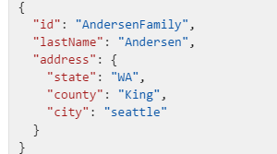
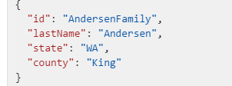
Nested Objects
A JSON document can contain properties, arrays and objects
SELECT f.id, f.lastName, f.address
FROM Families f
WHERE LENGTH(f.id)>5
This result returns an address
object which has 3 properties
You may refer to the address object and
it's properties in the SQL statement
in a nested format
SELECT f.id, f.lastName, f.address.state,
f.address.county
FROM Families f
WHERE LENGTH(f.id)>5

Slide 15
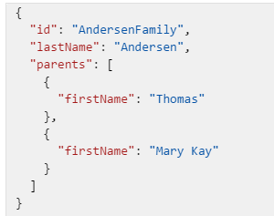
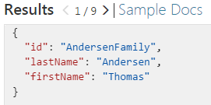
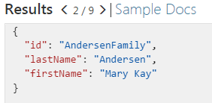
Treating arrays as sub-documents
A JSON document can contain properties, arrays and objects
SELECT f.id, f.lastName, f.parents
FROM Families f
WHERE LENGTH(f.id)>5
parents contains an array [ ] of values
An array of values may be treated
as a sub-document (think a M:1 relationship)
The sub-document may be included in the
FROM clause and requires a JOIN clause
SELECT f.id, f.lastName, p.firstName
FROM Families f
JOIN p IN f.parents
WHERE LENGTH(f.id)>5

Slide 16
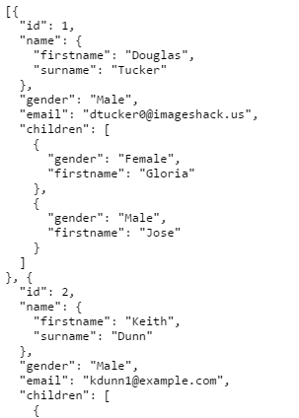
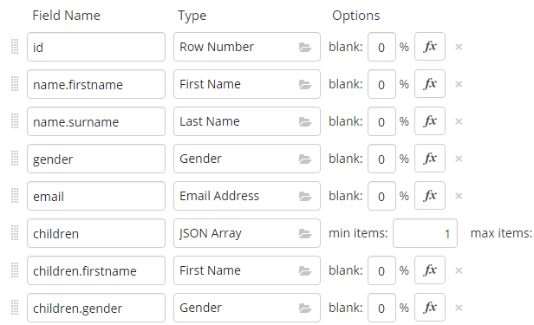
Create JSON data
If you want to practice creating JSON documents then you can visit https://www.mockaroo.com/
This site allows you to freely create a JSON document
with up 1000 entries

Slide 17
DocumentDB referecnes
https://azure.microsoft.com/en-in/documentation/articles/documentdb-sql-query/
https://www.documentdb.com/sql/tutorial
https://www.tutorialspoint.com/documentdb_sql/

